Slide 1

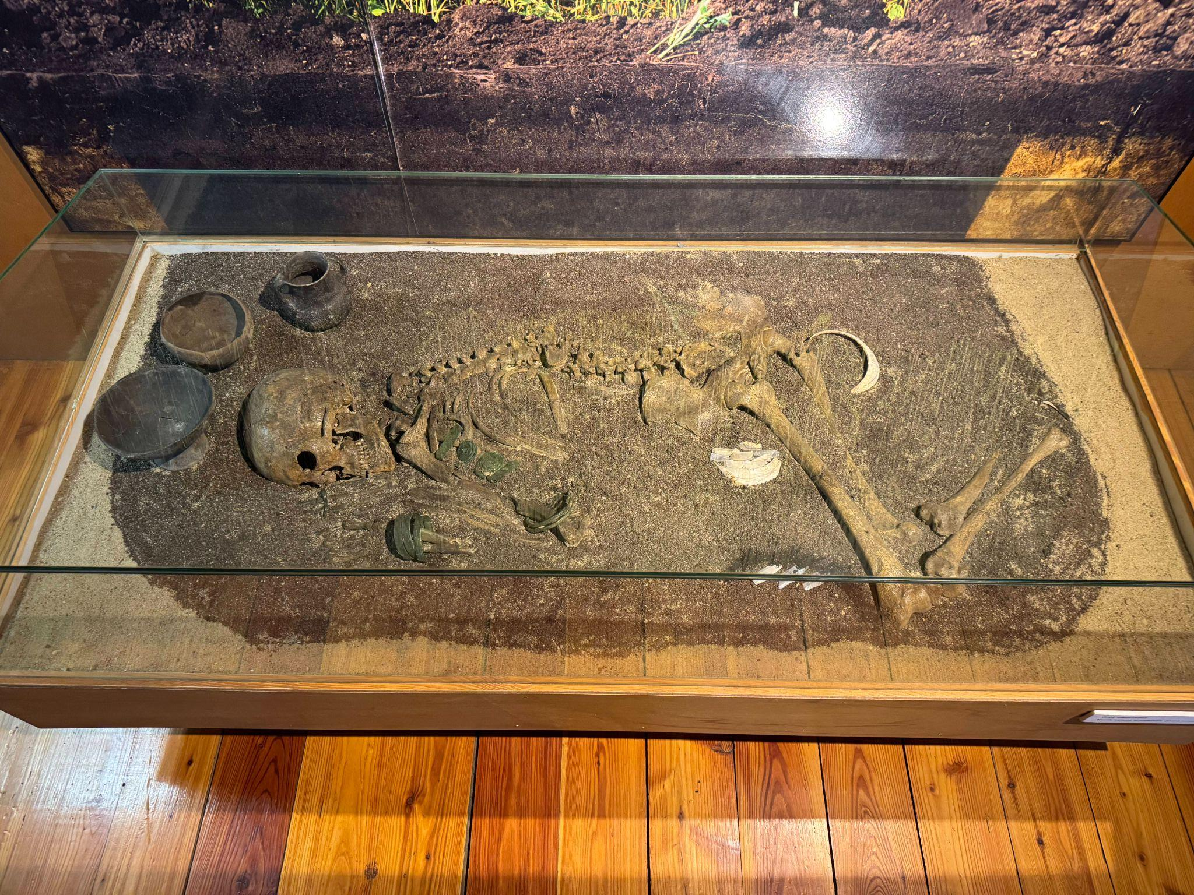
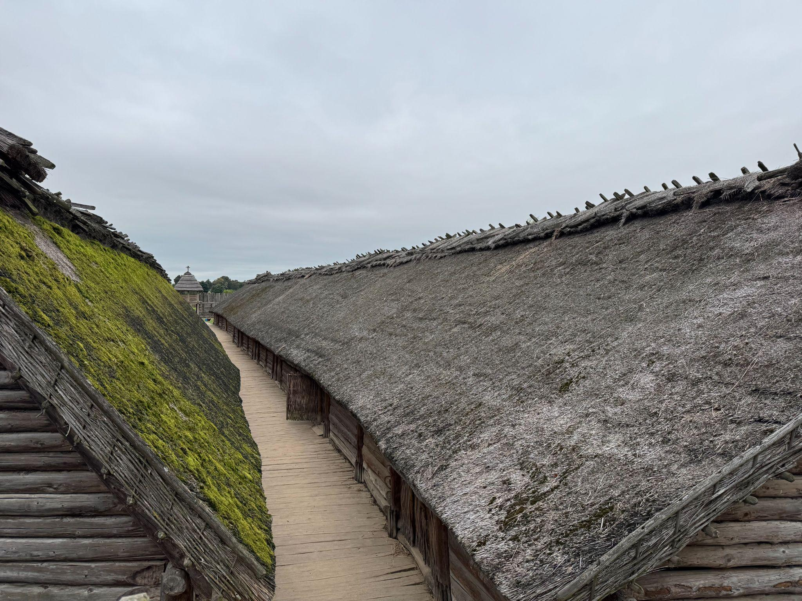
Ritual & Remains:
A study of ancient religions and those that observed them

Slide 2
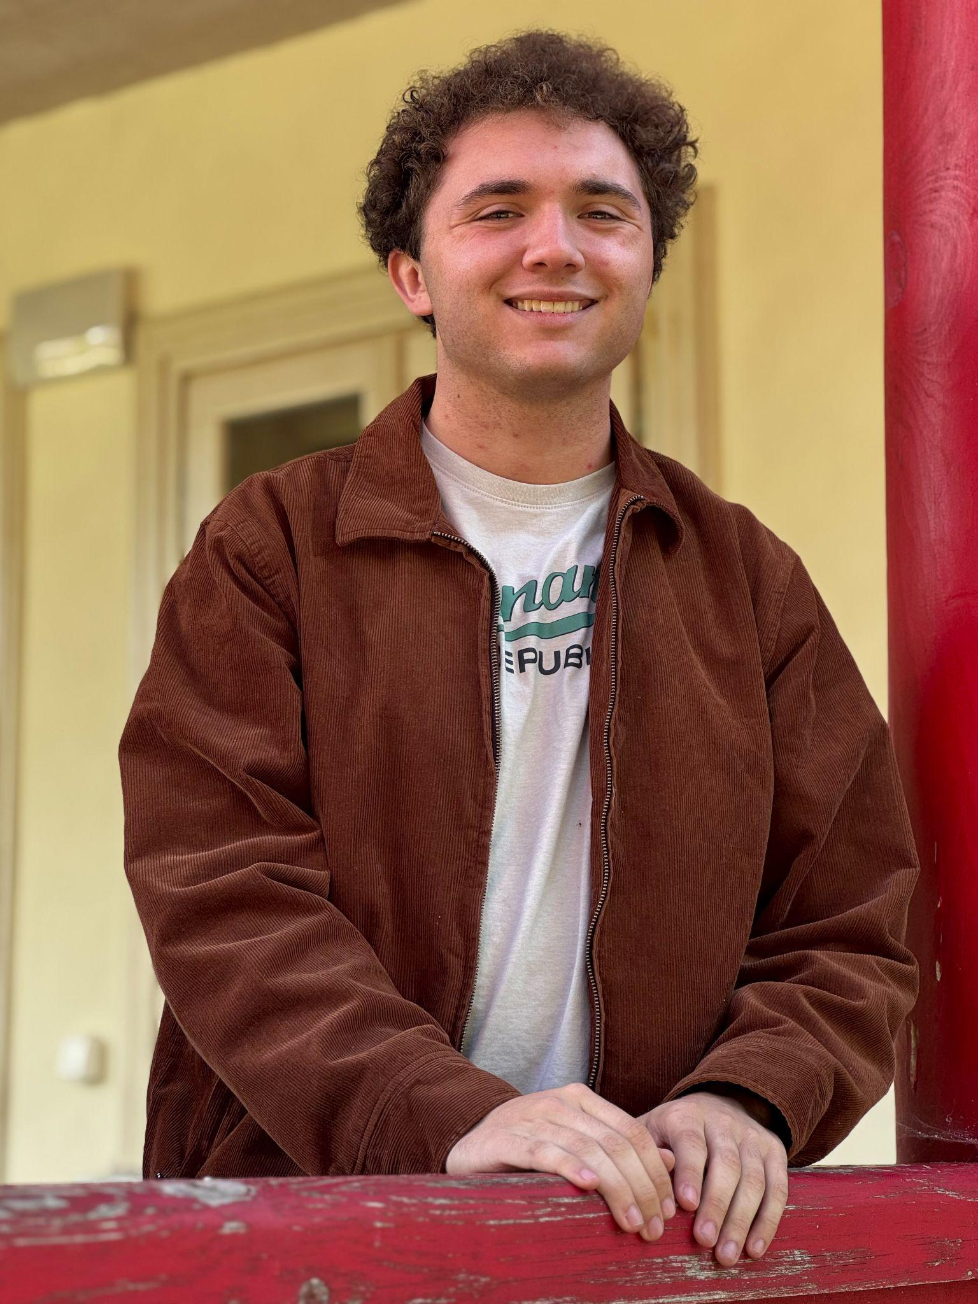
The Question:
How do the grave goods and burial architecture reflect the religious practices and beliefs of ancient cultures?

Slide 3
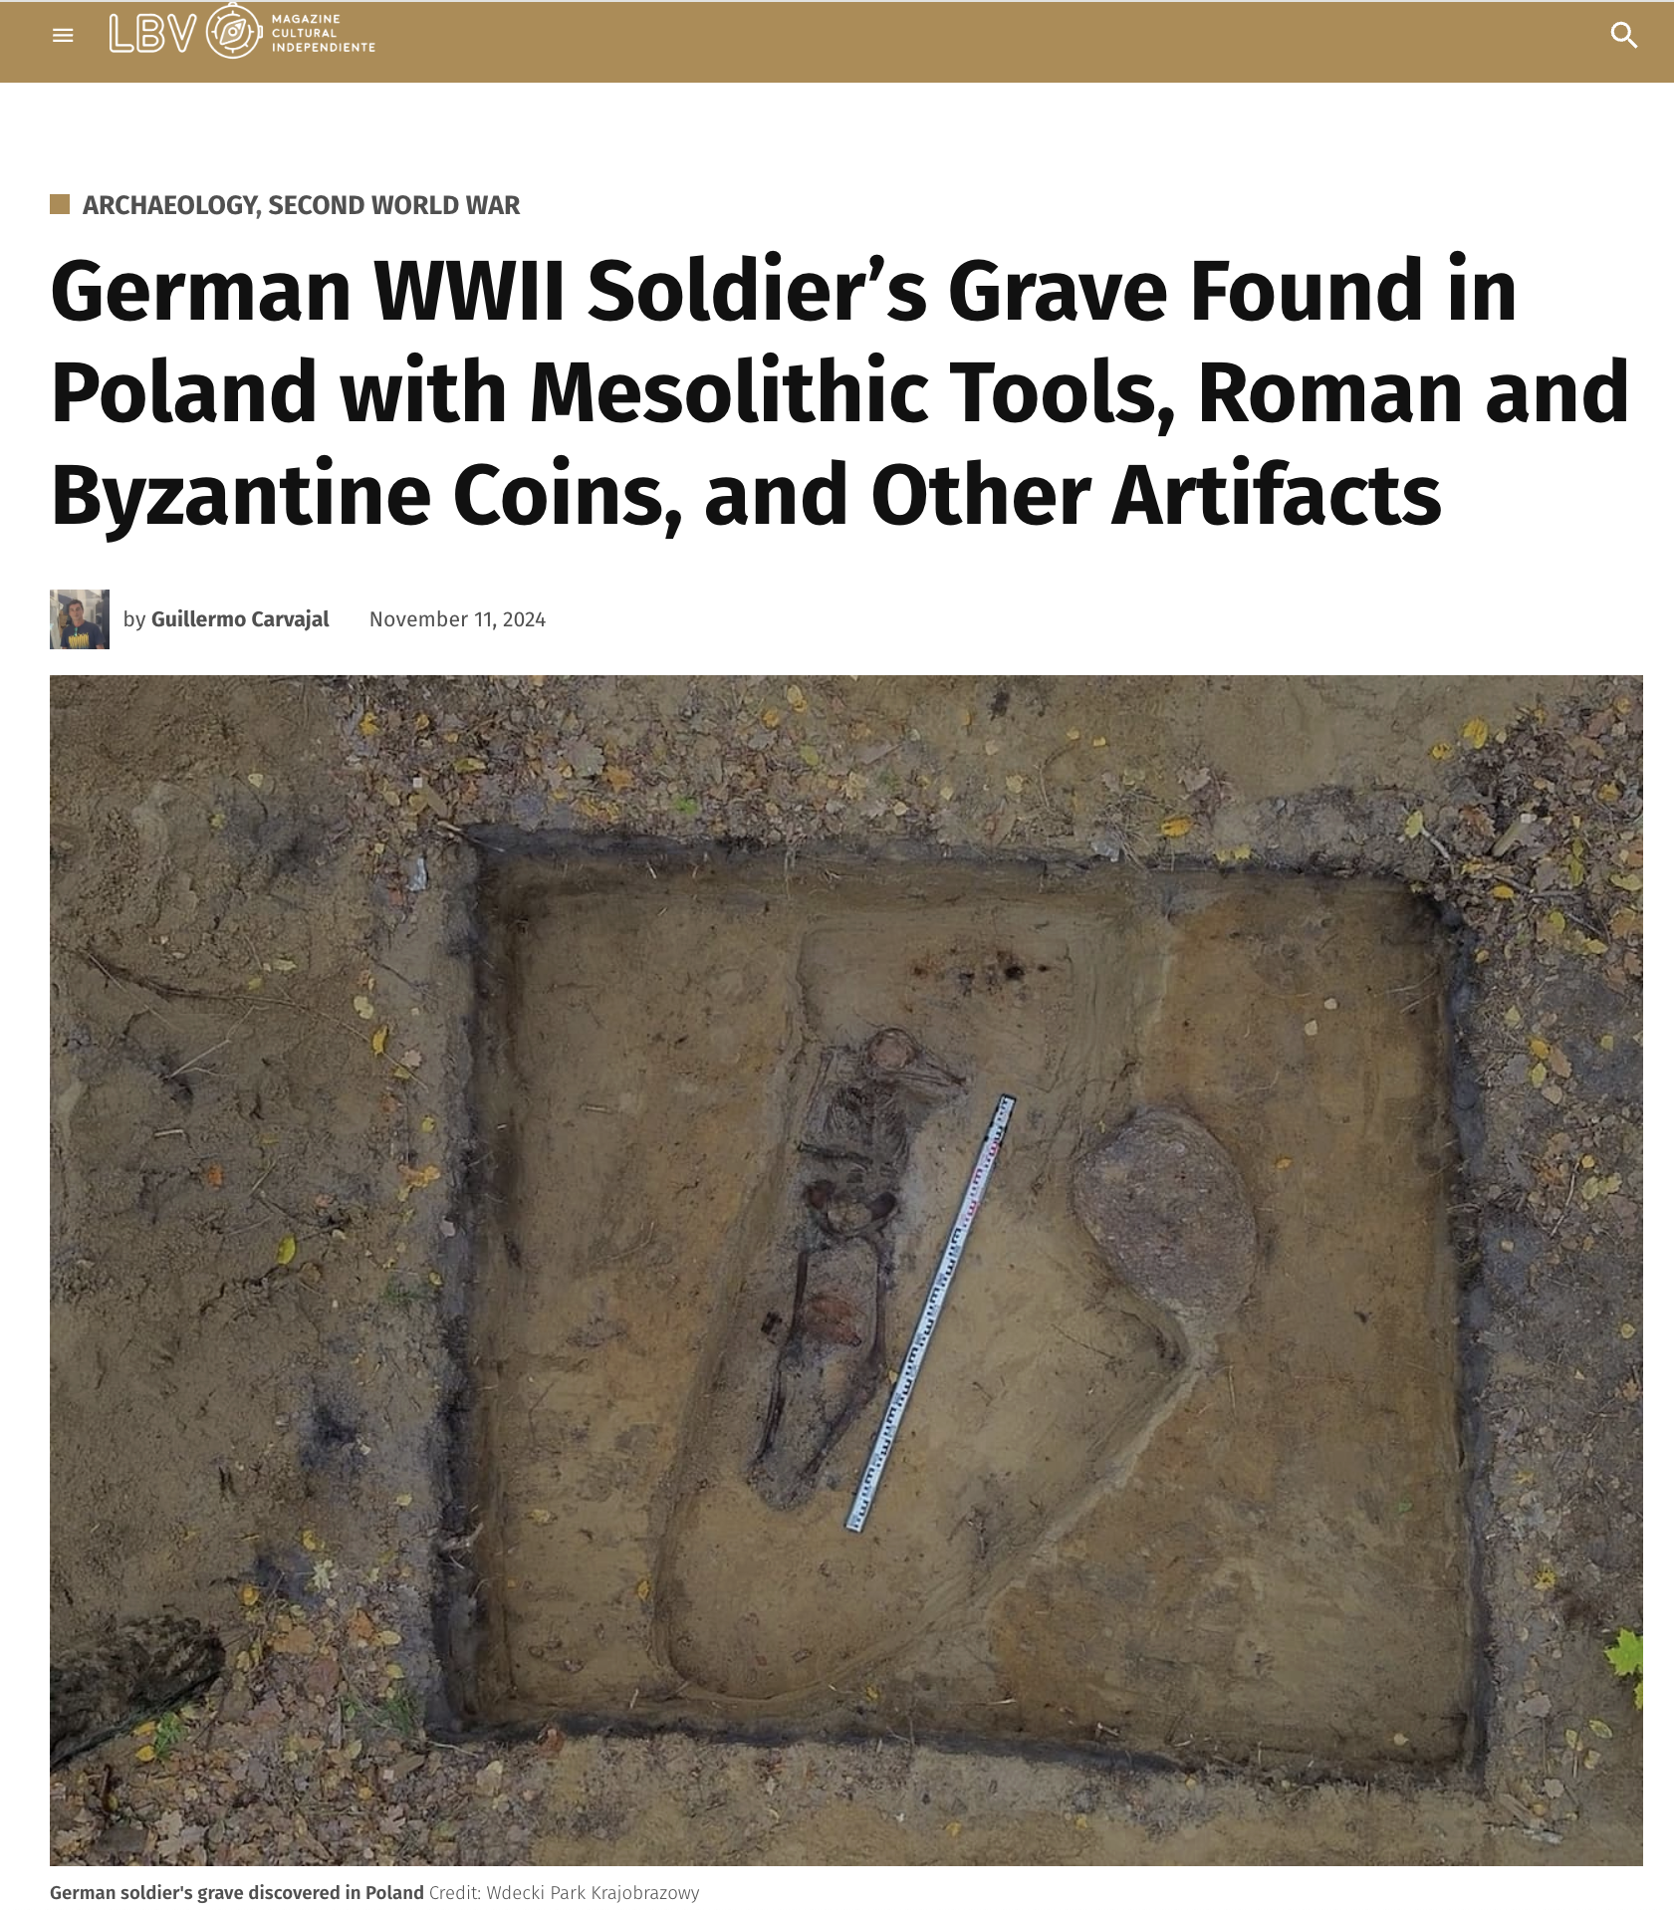

Slide 4
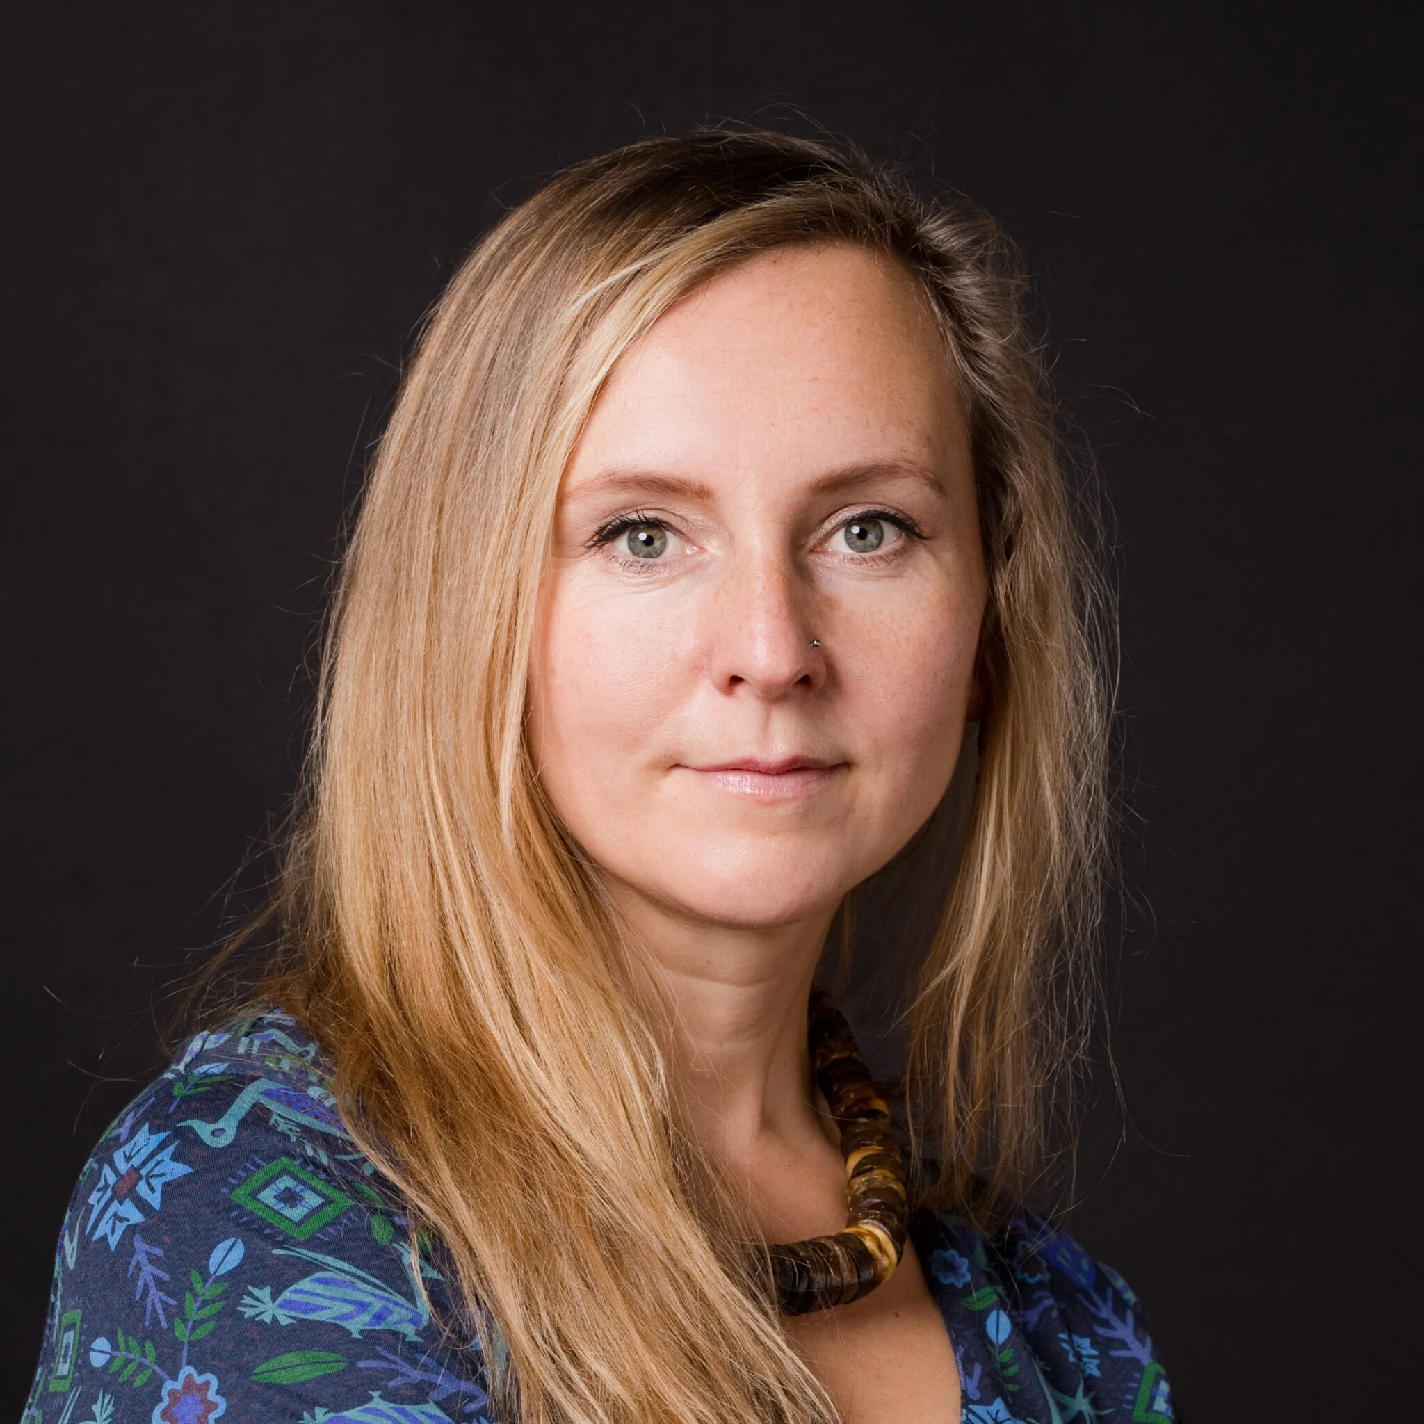

Some of the sources used
Professional Opinions:
Prof. Baron
Archaeologist & Professor at University of Wrocław
Facilities & Libraries:
University of Wrocław
Institute of Archaeology library

Slide 5
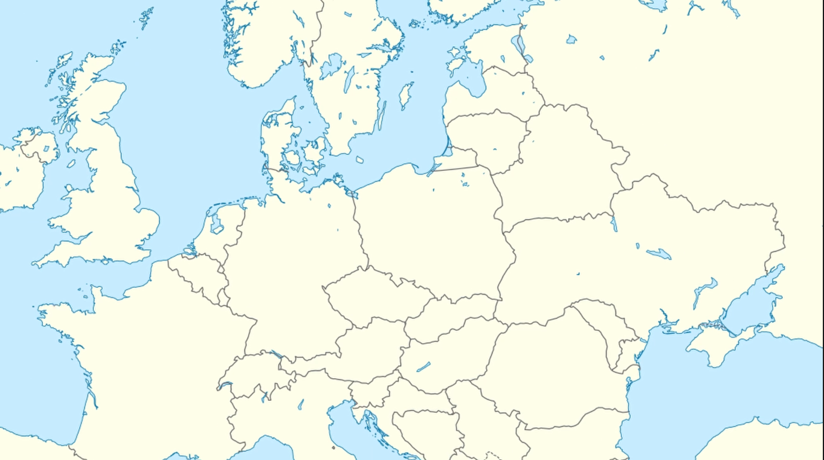

Lusatian Culture
Urnfield Cultures

Slide 6
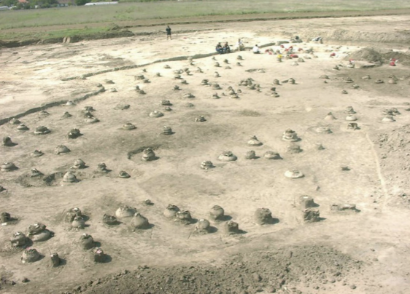
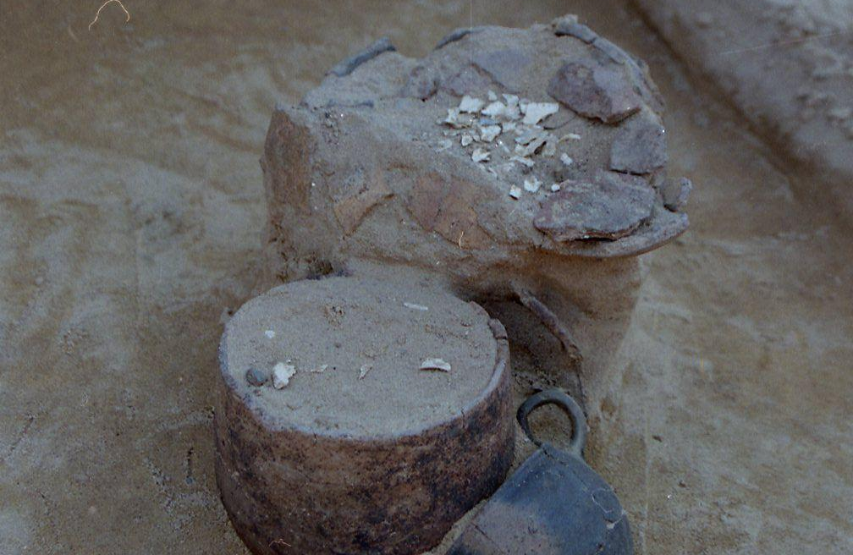
The Urnfields of the Bronze Age [1300-500 BCE]
An Urn with Human Bones
Excavation of an Urnfield in Hungary

Slide 7
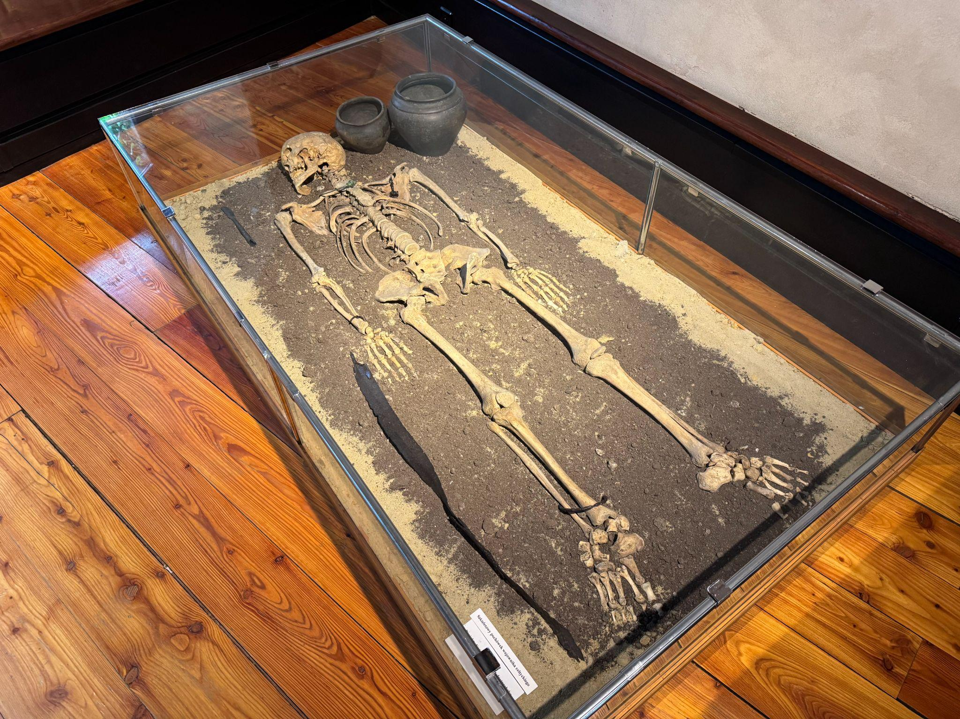
Common Goods & Burials
Deformed Weapons
Bronze Jewellery
3rd - 2nd Century BCE

Slide 8
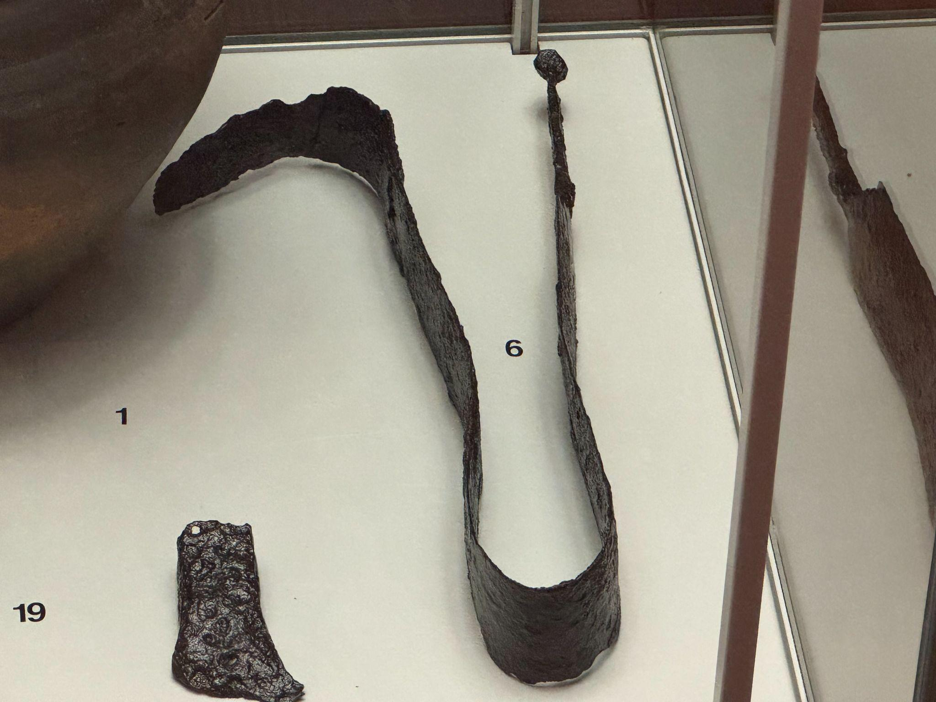
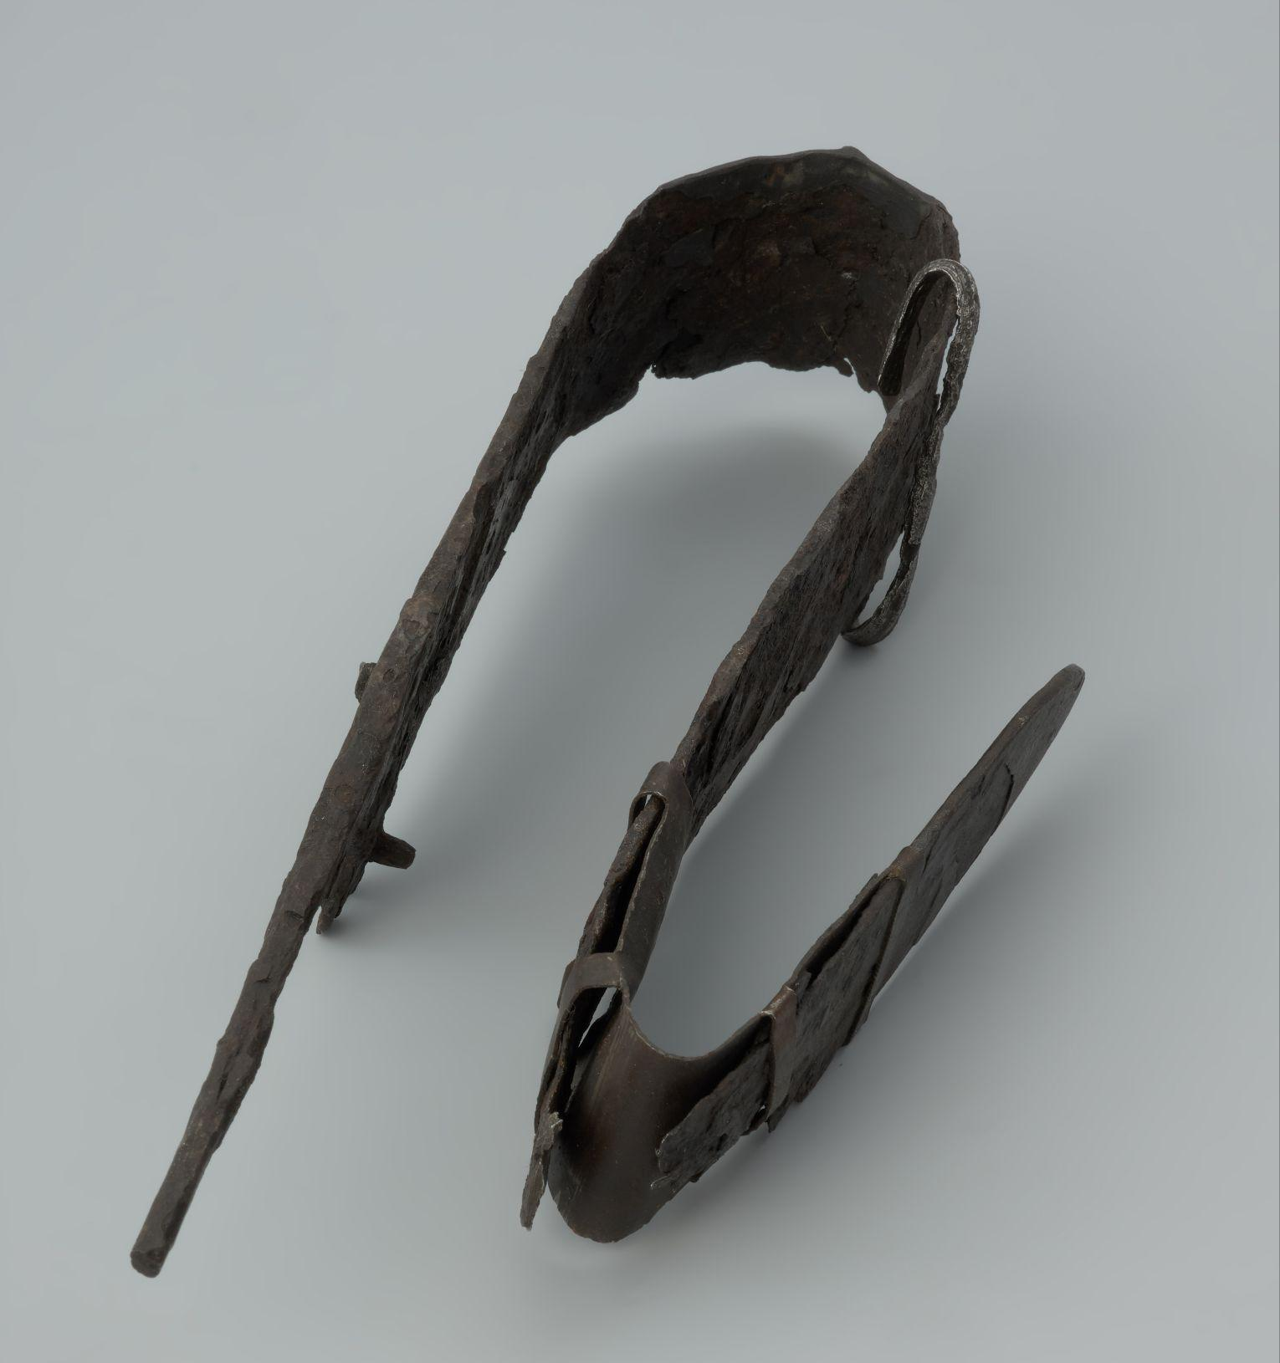
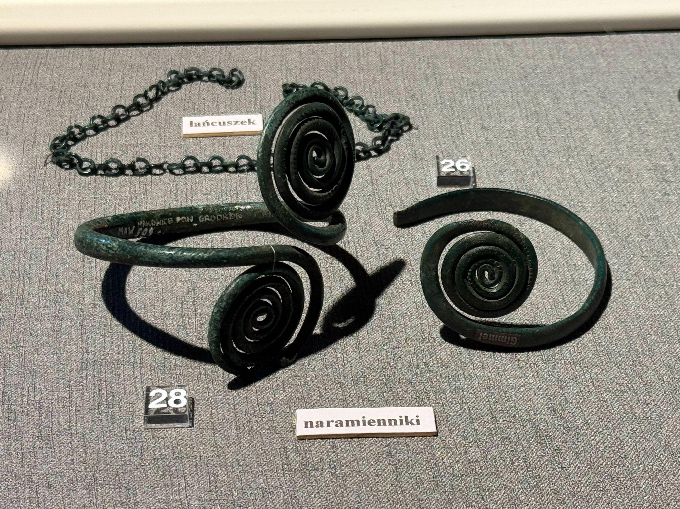
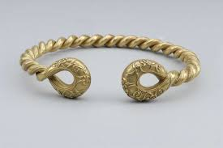
Comparisons & Theories:
Lusatian Deformed Blade
1250’s BCE
Celtic Deformed Blade
2nd Century BCE
Lusatian Arm Bands
1250’s BCE
Celtic Torc
2nd Century BCE

Slide 9
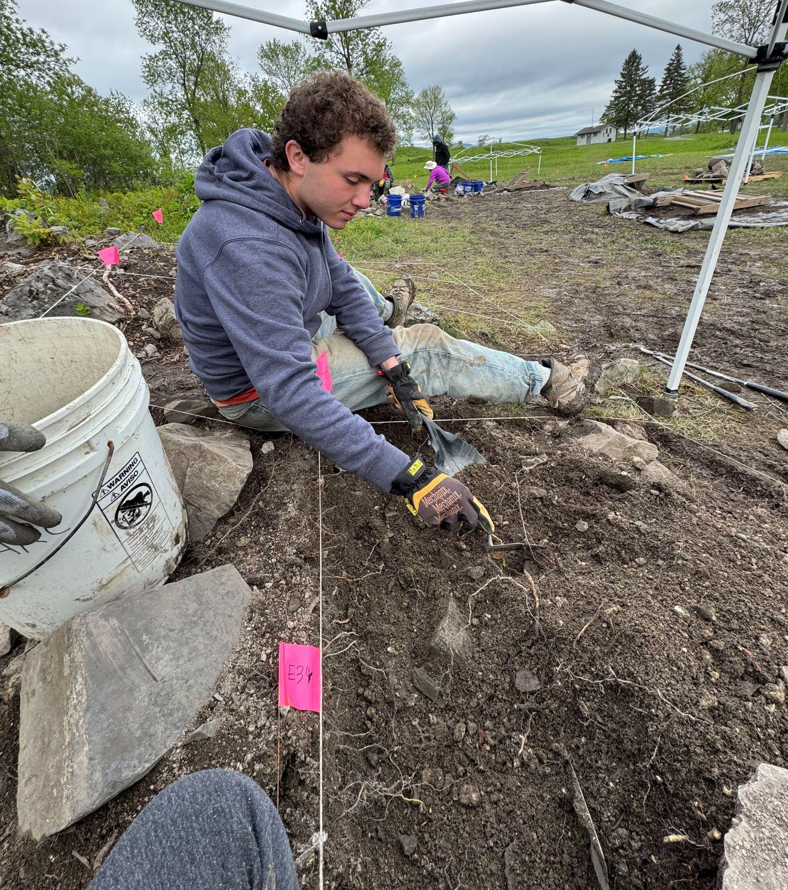
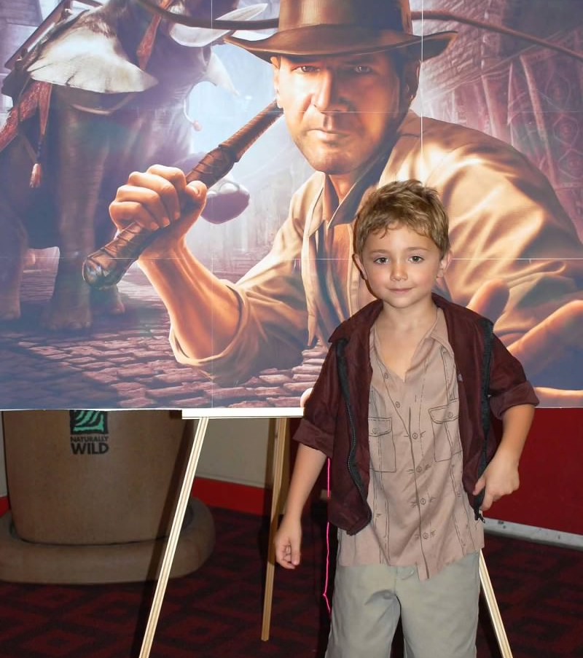
Why do we study this?
(Mini Blake as Indiana Jones)

Slide 10
Ritual & Remains:
A study of ancient religions and those that observed them

