Slide 1

Immigration and Argentine Tango
By Naomi Rees

Slide 2
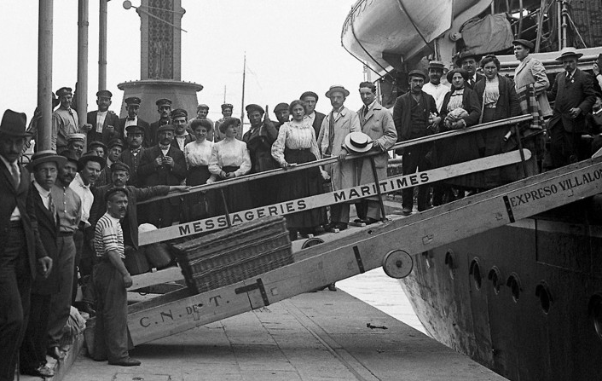
Question:
What impact did immigration
have on Argentine Tango?
Rationale:
From 1870-1950, Argentina experienced massive levels of immigration. During the same time period, from 1870-1920, Argentine tango was developing as a dance. I was curious how the two interacted.

Slide 3
Methods:
I researched using libraries in Buenos Aires, public records online, and published studies on Argentine tango.
One of the most helpful resources I found was a study on the influence of gauchos, which an Argentine man suggested. I wouldn’t have found all of that information had I not been in Argentina.

Slide 4
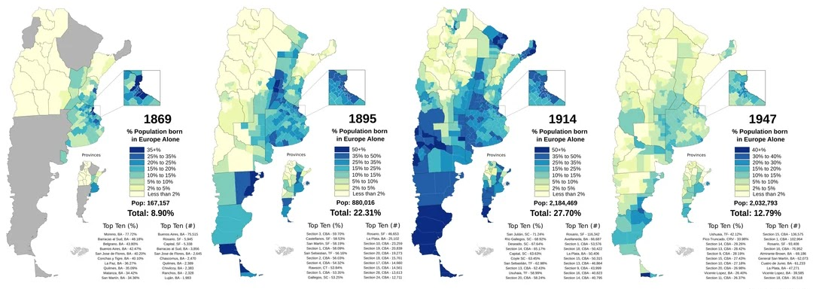
European Immigration to Argentina 1869-1947
Source: Wikipedia

Slide 5
Forced African Immigration to Argentina 1535-1853
20% of Buenos Aires was African in 1836
Source: Erika Denise Edwards

Slide 6
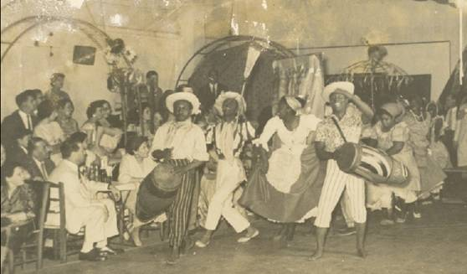
Candombe
West African drumming circles

Slide 7
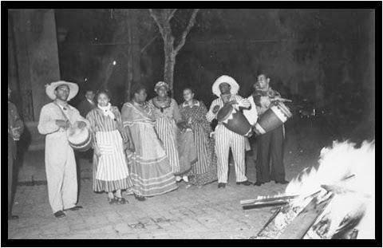
Milonga
Hybrid of Andalusian Spanish music and candombe

Slide 8
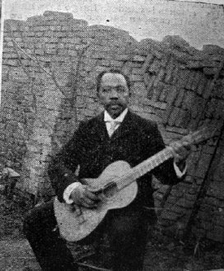
Gabino Ezeiza
Afro-Argentine musician and composer
Popularized milonga music in the 1870s and 1880s

Slide 9
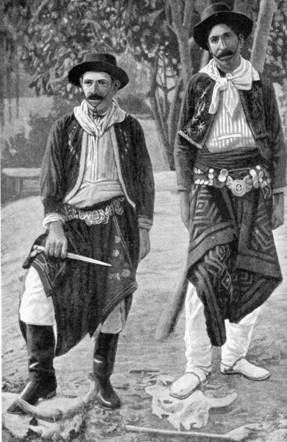
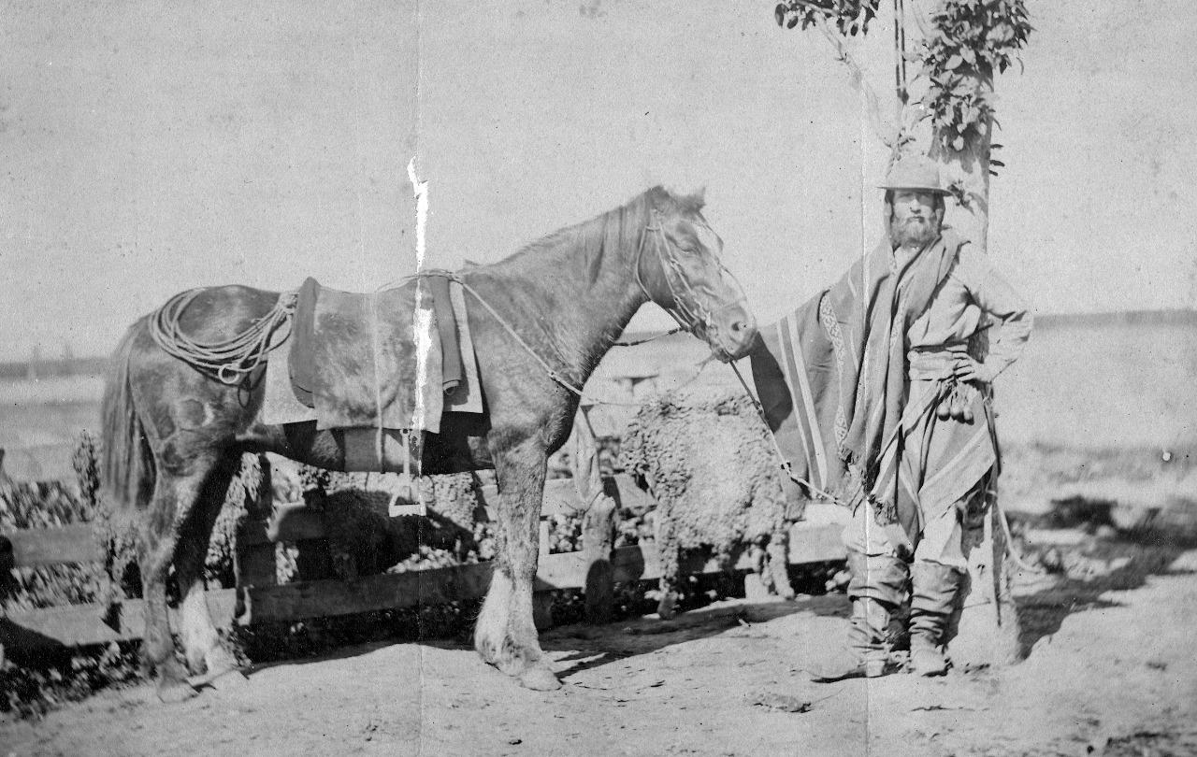
Argentine Gauchos

Slide 10
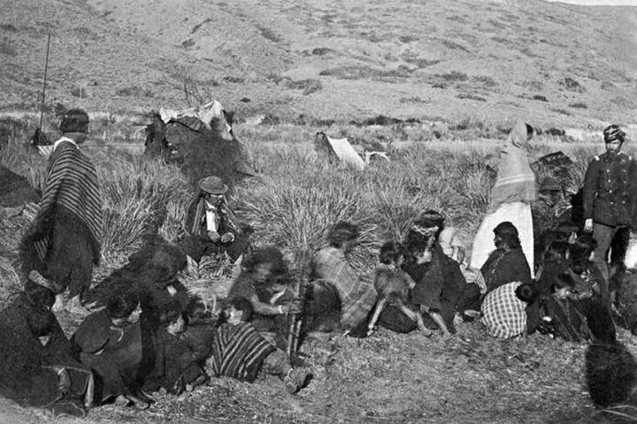
Conquista del Desierto (Conquest of the Desert)
Military operation from 1878-1885
Removed native people from Patagonia
Reallocated the land to European immigrant farmers
Relocated gauchos to cities

Slide 11
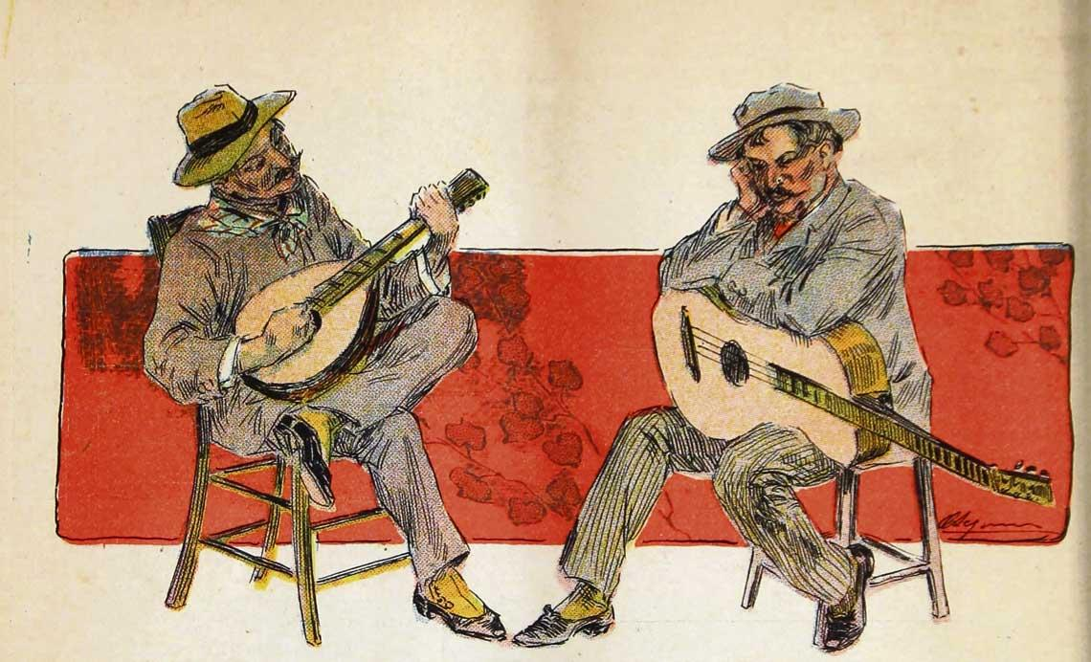
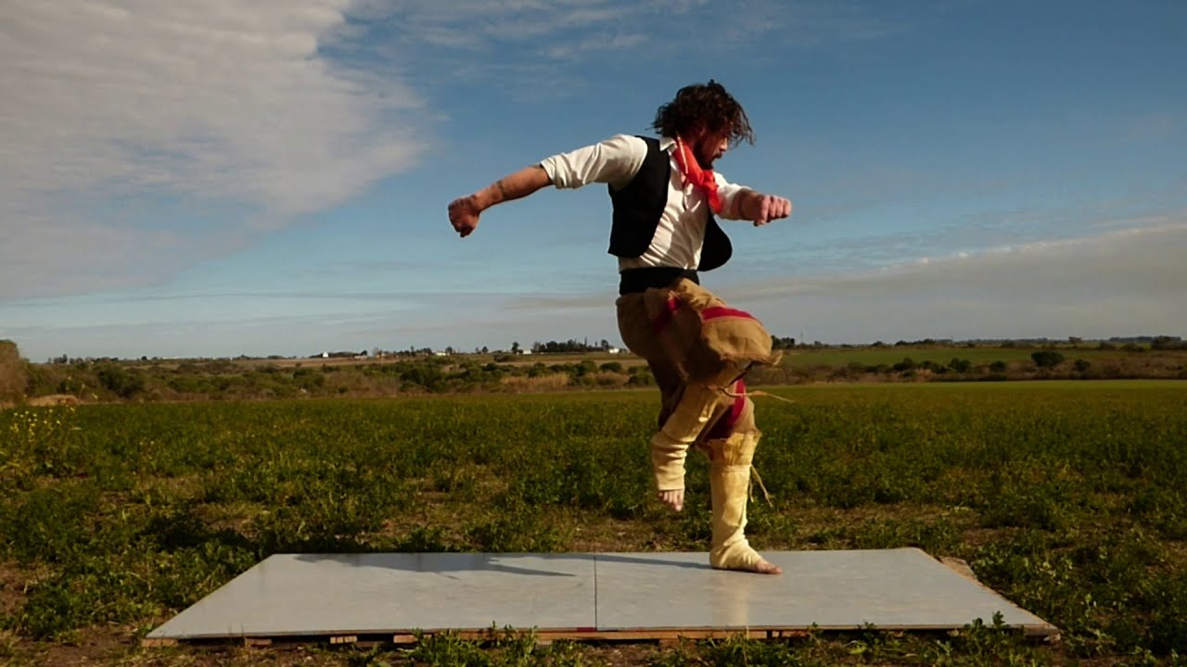
Gaucho Customs
Payada
Malambo
Musical tradition of dueling guitars
Gaucho dance with rapid, high energy footwork

Slide 12
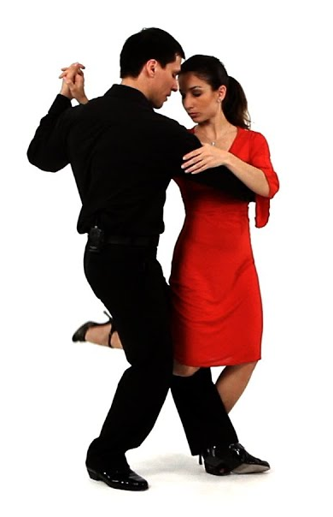
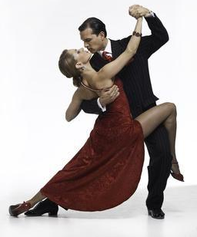
Tango steps from gaucho influence
Gancho (hook)
Quebrada (broken step)

Slide 13
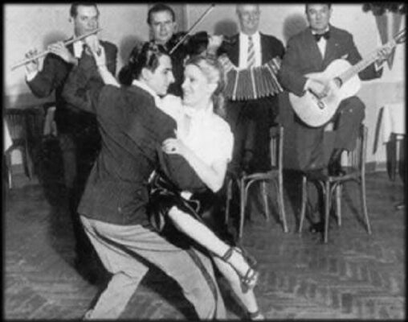
Key Takeaways:
Tango is a creation of diversity
The most uniquely Argentine
art form would not exist
without immigrants

Slide 14
Limitations:
Time
Fluency in Spanish

Slide 15
Relevance:
Immigration strengthens countries
Argentine tango is a source of national pride and heritage, created by people seeking a better life

Slide 16
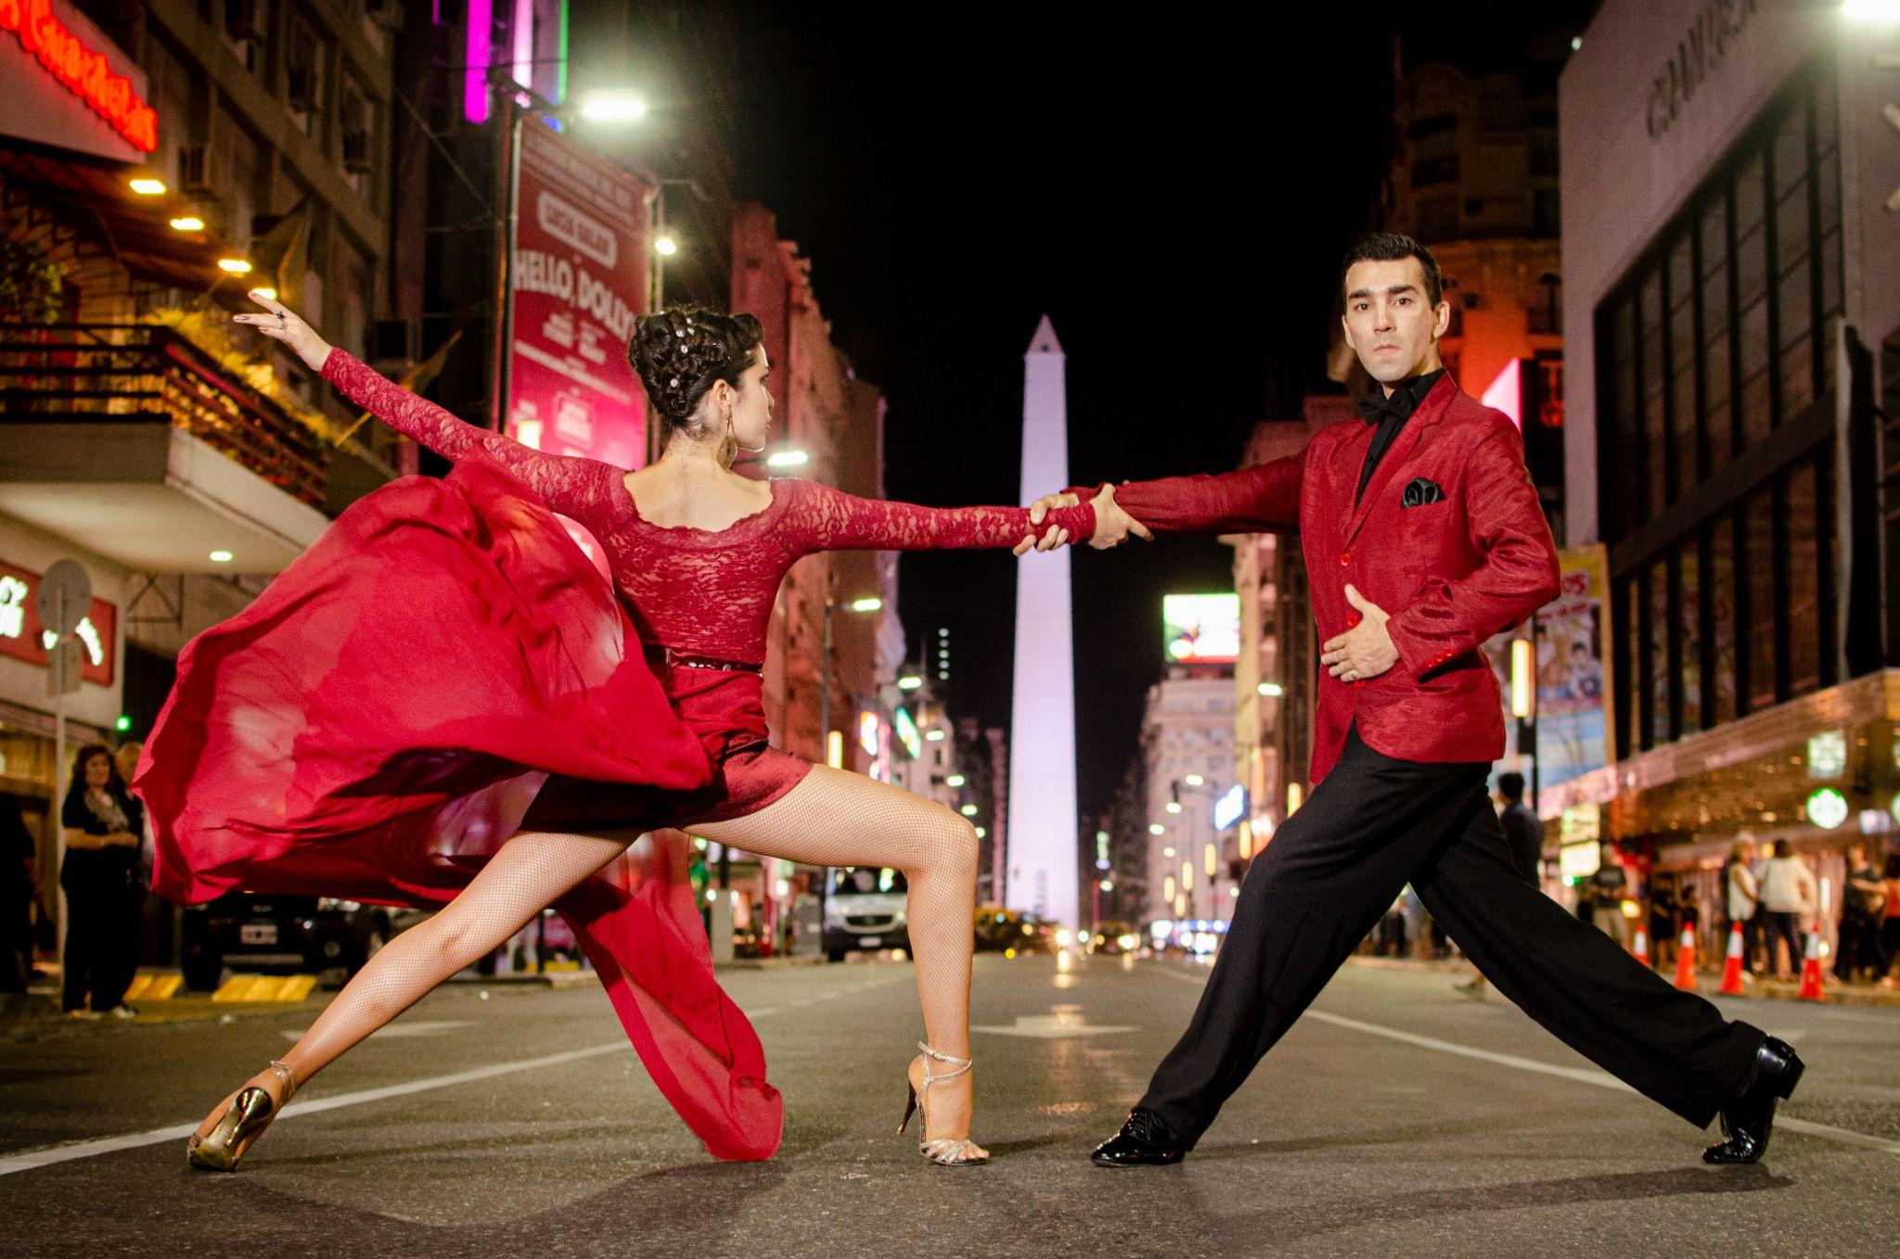
Thank you!

