Slide 1

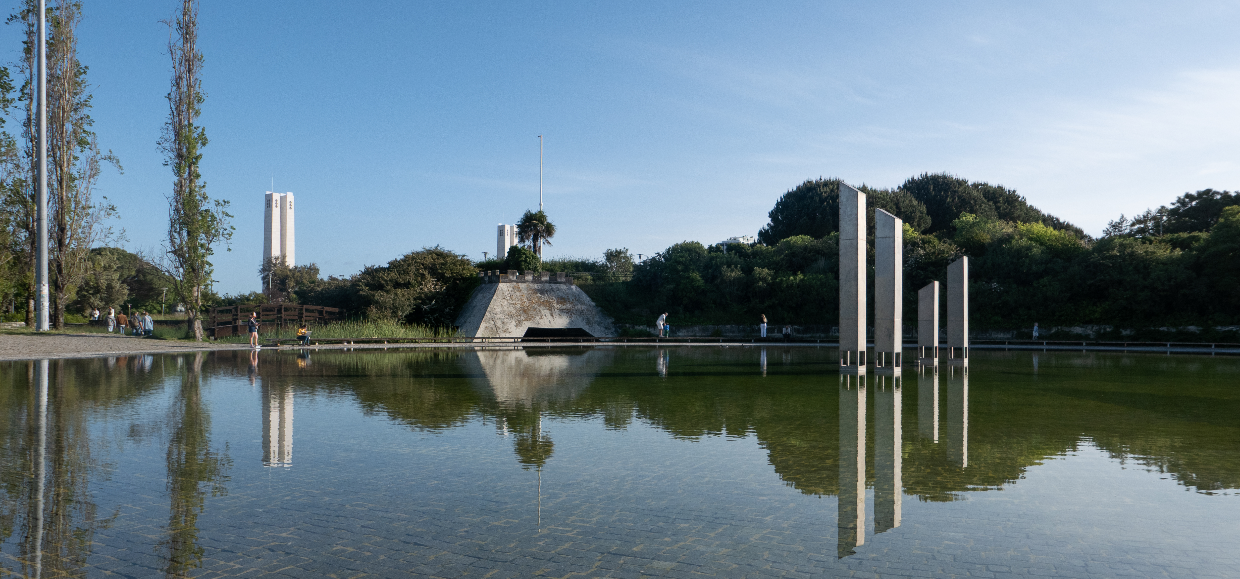
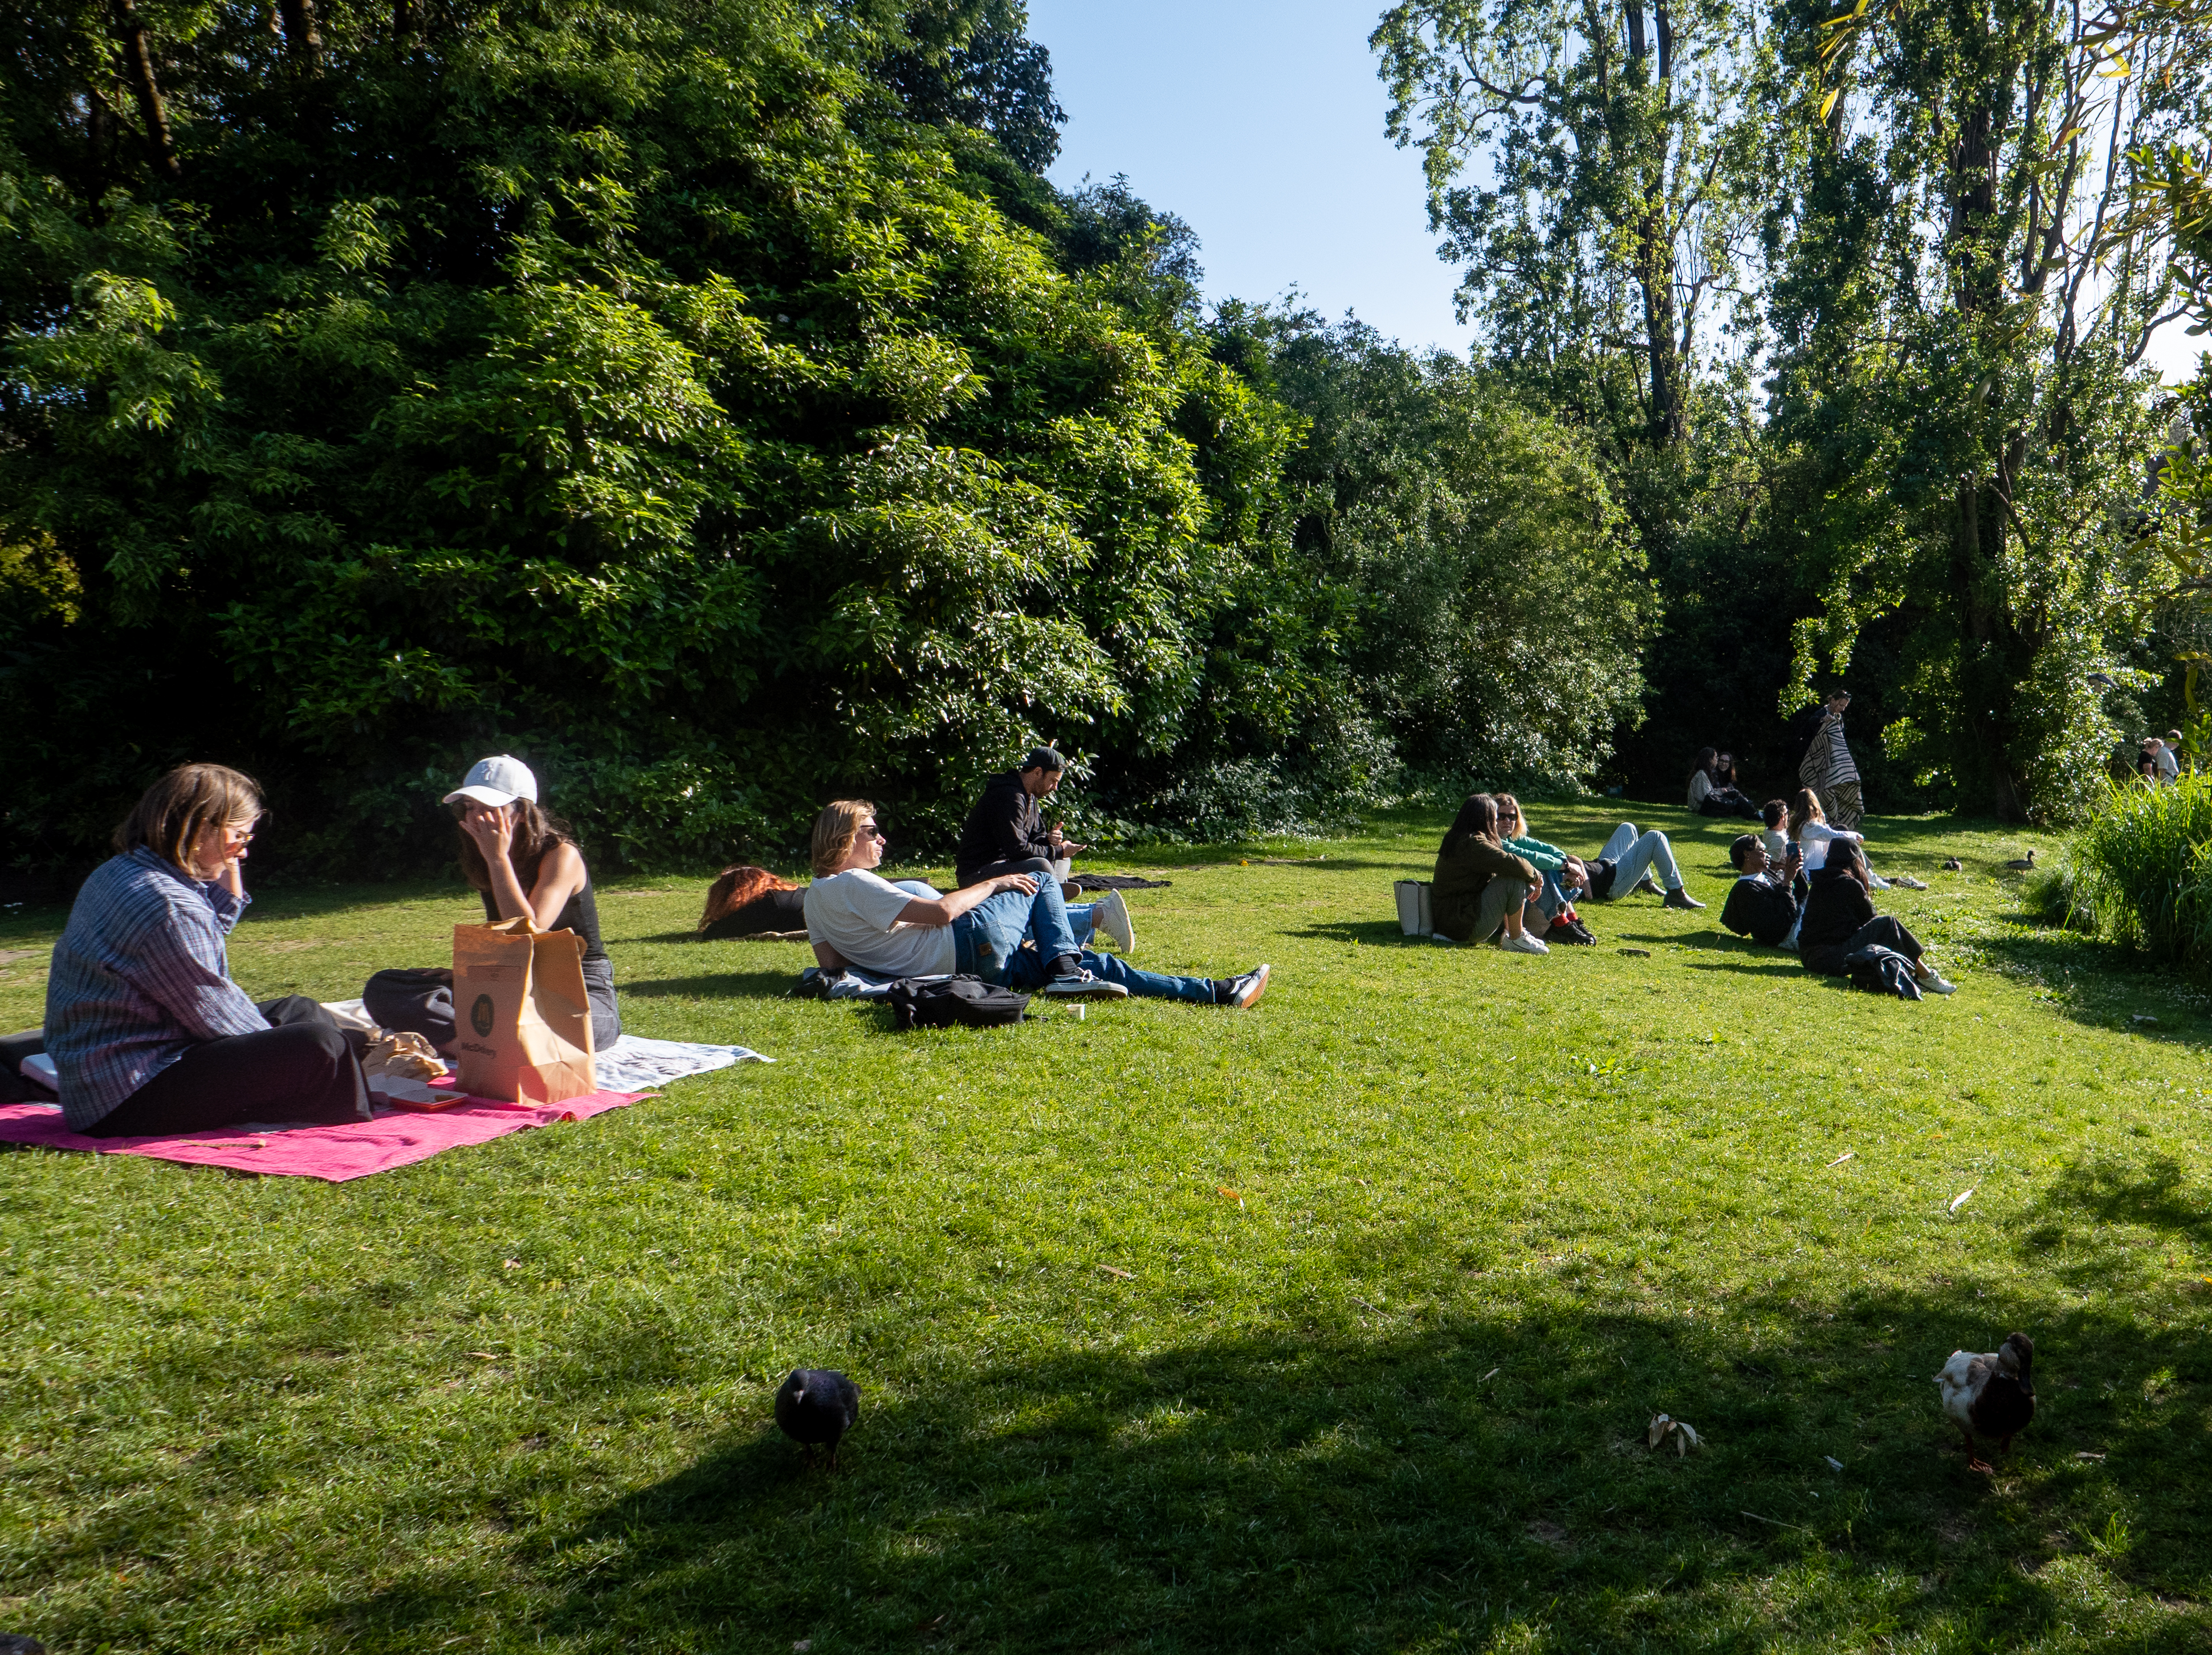
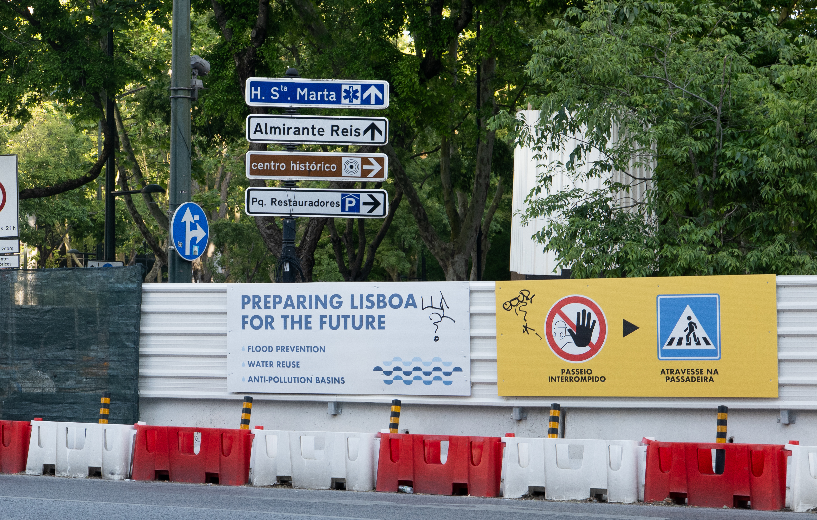
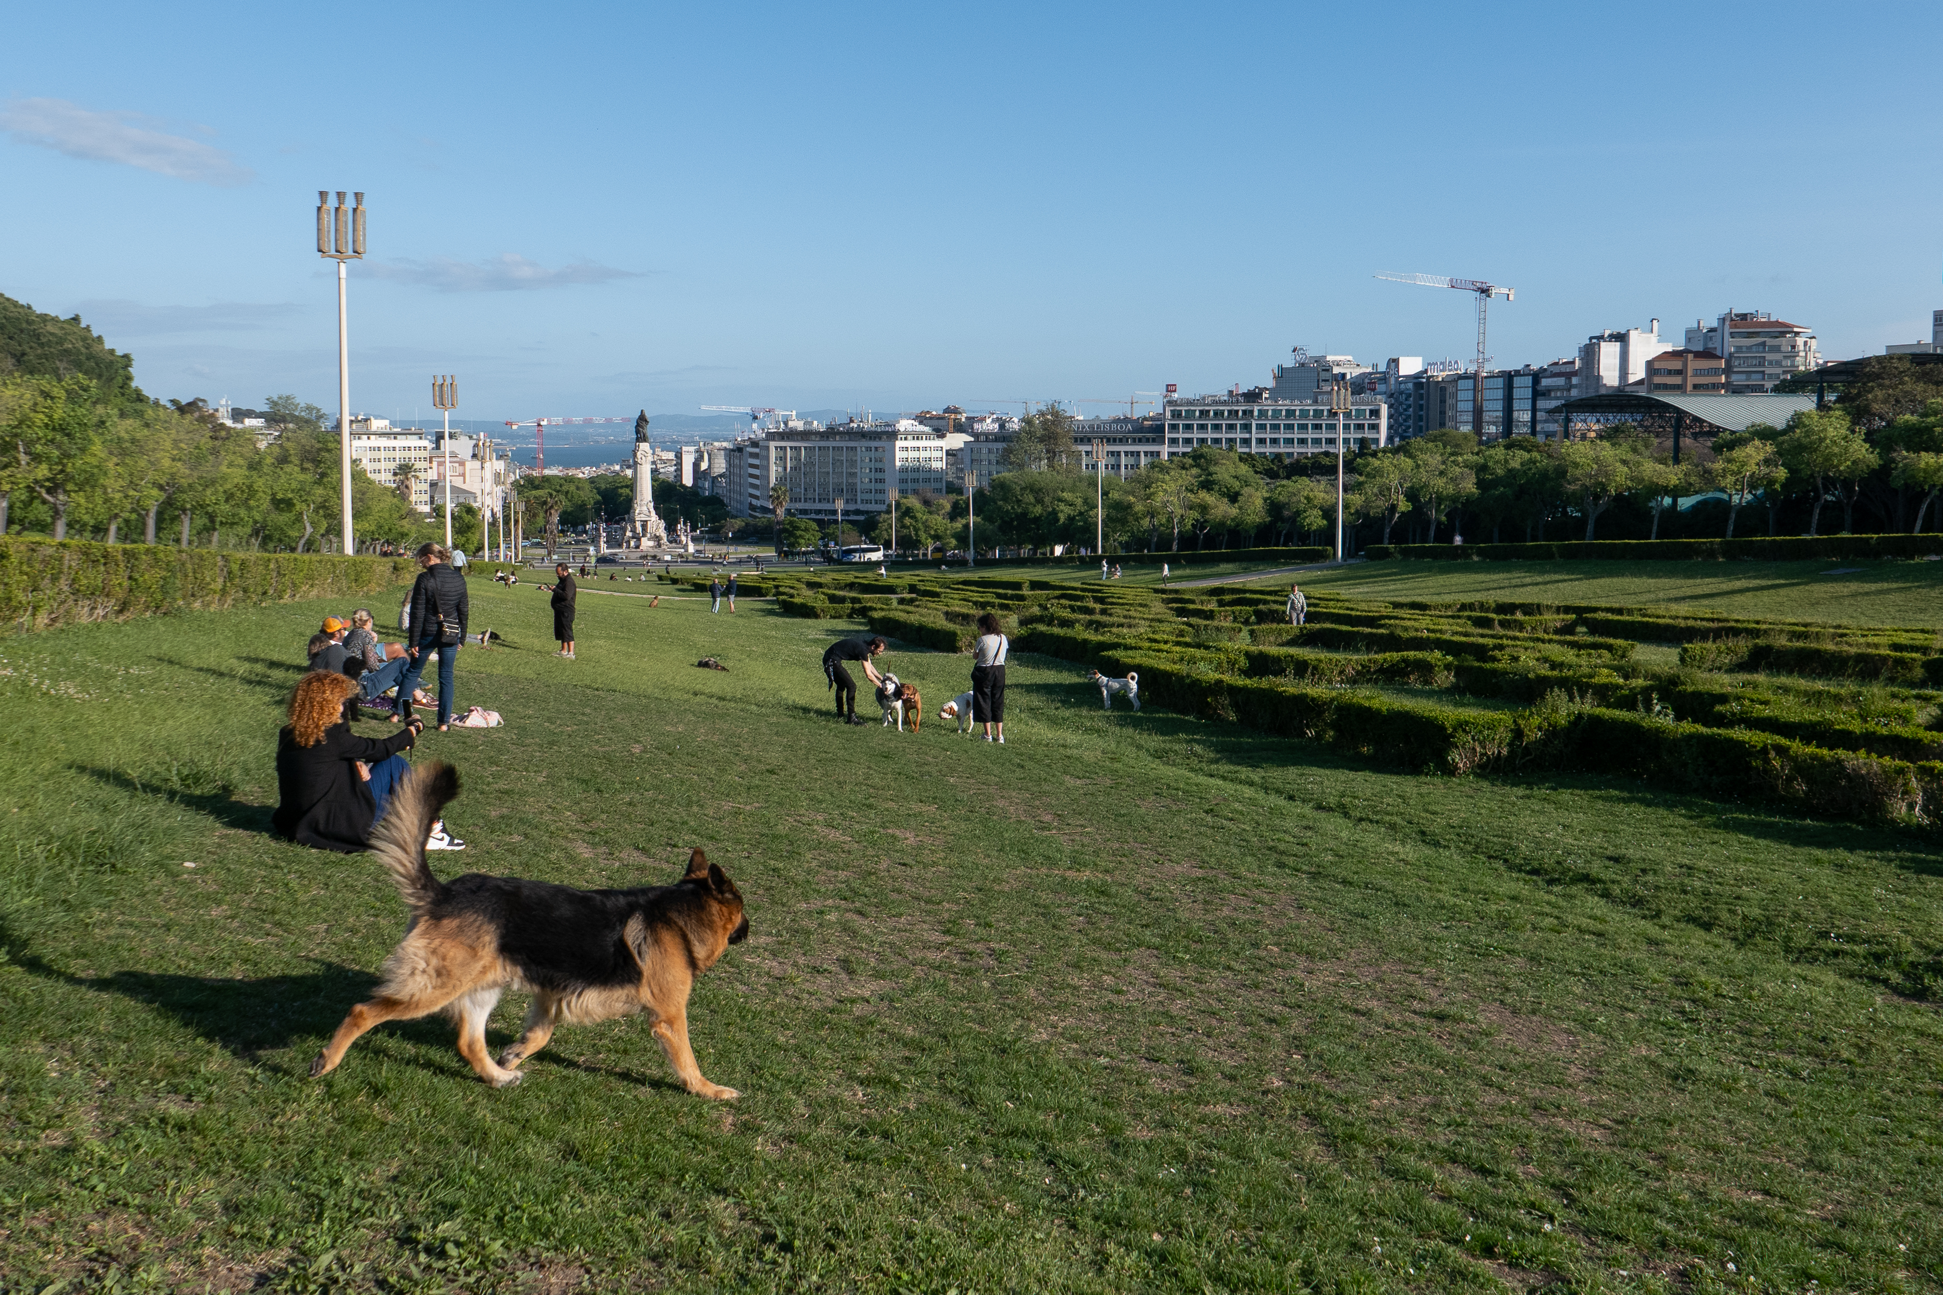
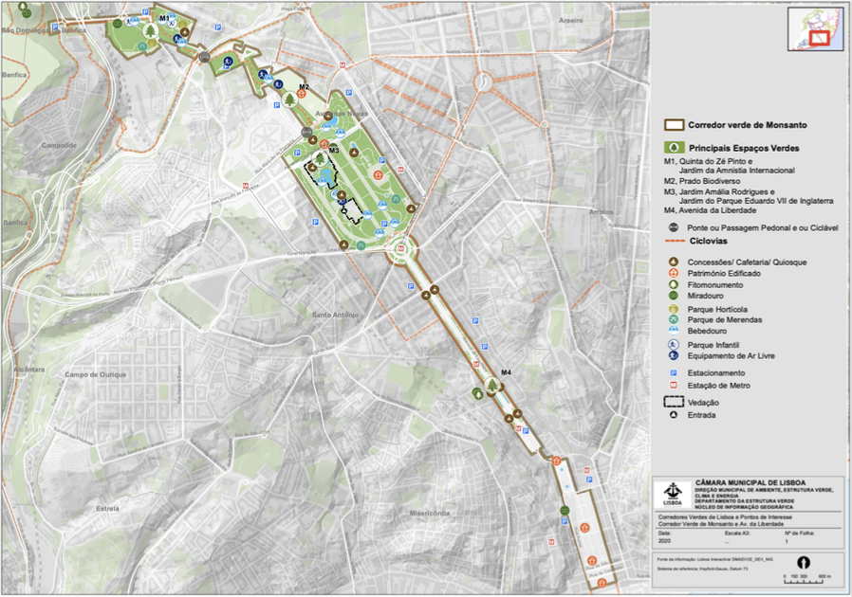
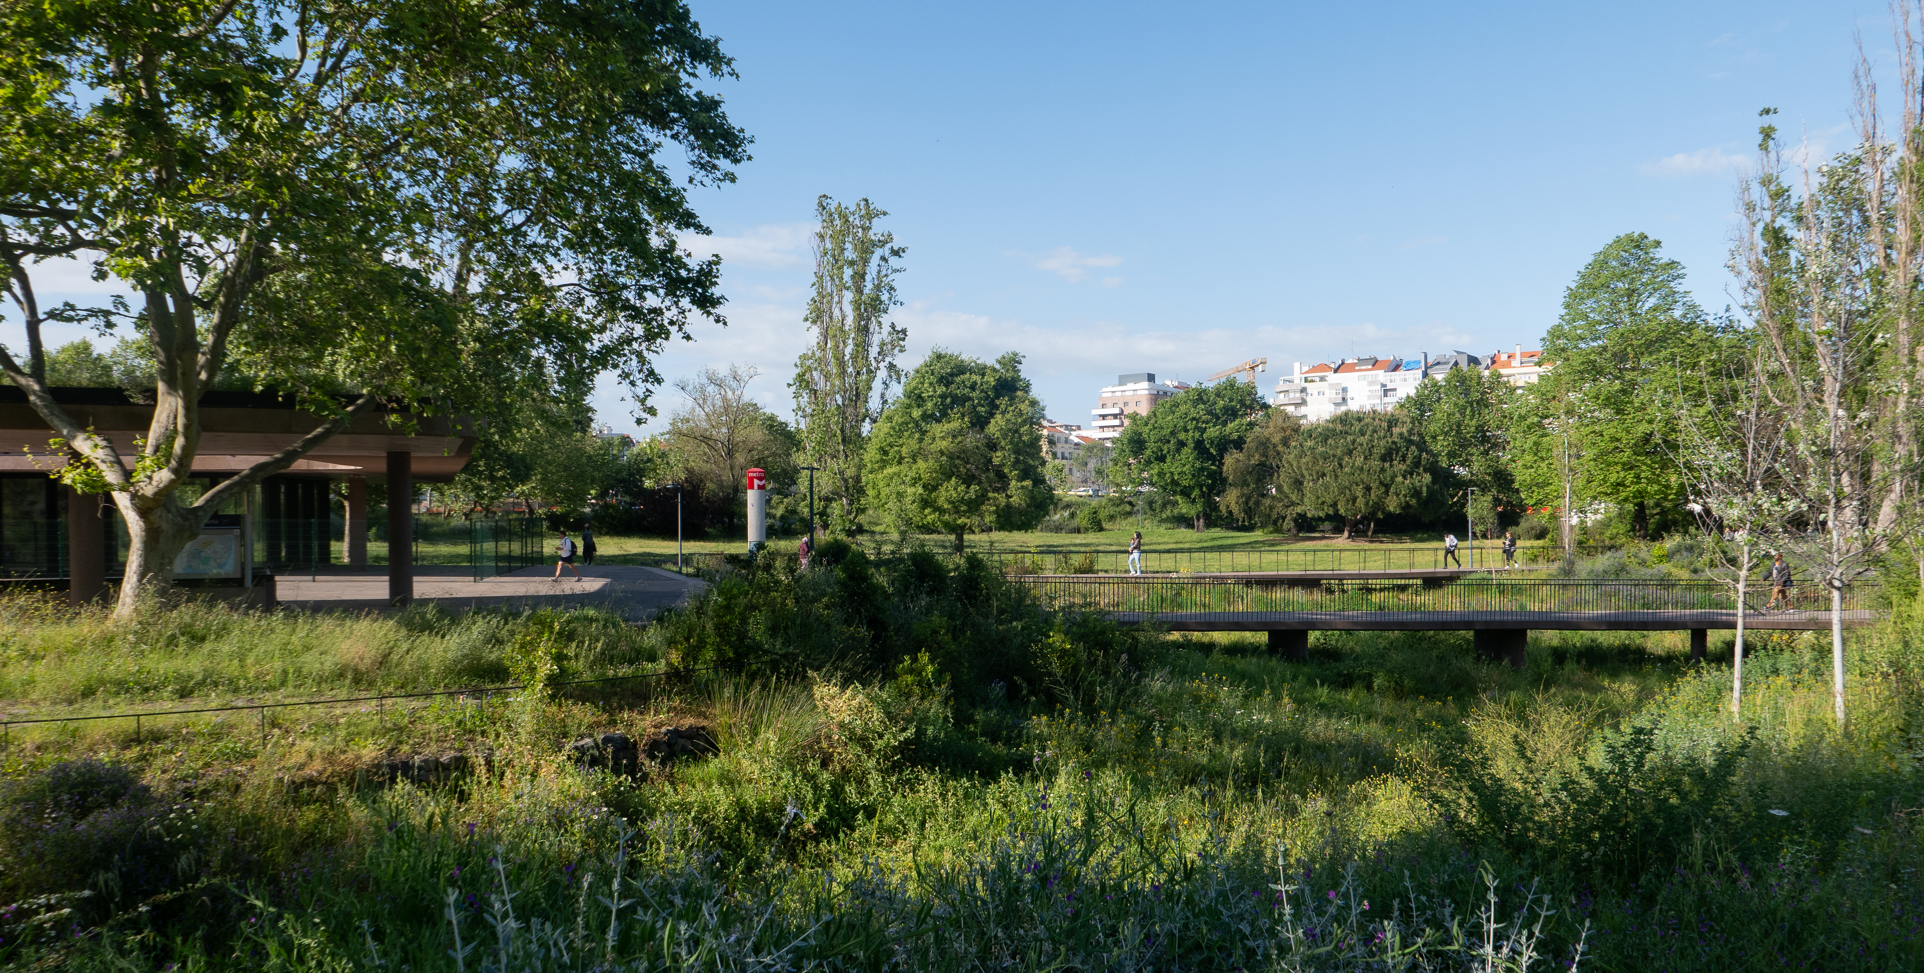
Enhancing Urban Water Drainage in Avenida da Liberdade: Evaluating Green Spaces and Sustainable Infrastructure in Lisbon’s Master Drainage Plan
Eva Asfahani
¹Department of Integrative Biology, College of Natural Sciences, The University of Texas,
²School for International Training
Introduction
Figures and Results
Conclusion
Lisbon is a highly developed and historical city.
Tsunami in 1755 following the earthquake that destroyed most of the city, as well as the 1967 floods that killed more than 500 people. In December 2022, massive floods caused hazardous incidents, leading to emergency evacuations around the city (Davies, 2022).
Gray infrastructure, or “traditional stormwater infrastructure in the built environment such as gutters, drains, pipes, and retention basins” (EPA, 2018) has historically been used to navigate urban water drainage.
  Pollutants and flood risk
Green-Blue infrastructure is an example of a nature-based solution that implements green spaces (grass, plants, trees, etc.) and water areas (ponds, lakes, etc.) to reduce flood risk while promoting social and environmental benefits.
L1080561.jpg
Research Goal
Image 4: Residents in Lisbon enjoying social benefits of GBI.
Image 2: Jardim Amália Rodrigues. This garden within the Monsanto Green Corridor provides a green space for gatherings and outdoor activities and encourages locals to dine at the scenic cafe, boosting local economies. It houses sculptures within the green and blue spaces, providing cultural experiences to local communities and increasing value of the area.
Lisbon’s urban planners have successfully incorporated sustainable development into their urban systems, particularly in the management of water drainage.
Within the Monsanto Green Corridor, Avenida da Liberdade serves as a key example of this hybrid model, demonstrating both the successes and the areas where further integration of sustainable infrastructure is possible.
Lisbon’s approach offers valuable lessons for other historic cities seeking to implement BGI despite spatial and technical constraints.
Explore the history of nature-based solutions and use this knowledge to analyze Lisbon’s use and implementation of them in their urban drainage plan. Study the economic, environmental, and social benefits of Green-Blue Infrastructure and analyze how the municipality effectively incorporates these nature-based solutions into their drainage plan.
1. Retention Basins
2. Reservoir Pavement
3. Absorption Wells
4. Infiltration Trenches
5. Swales
Reduce surface runoff, enhance groundwater recharge, and filter pollutants at the local scale
Methods
PGDL achieves a notable reduction in peak runoff flows by 20–50%, a reduction in runoff volumes by 15–30% (suspended solids by 50–90%, organic load by 50–70%, and metals by 75–95%)
Fosters community cohesion by providing recreational spaces that promote social interaction and public health. Reductions in stress and anxiety, increased physical activity.
Acknowledgments
Special thanks to Cátia Magro and Joana Dionísio for their dedication to the SIT program. Thank you to Dr. Catarina Roseta Palma for the support and guidance, ad Dr. Vasco Rato, Manuela Melo, Pedro Duarte, and João Rodrigues for their insights.
References
1. Câmara Municipal de Lisboa. (n.d.). Ambiente, Estrutura Ecológica, corredores verdes - município de lisboa.
https://www.lisboa.pt/cidade/ambiente/estrutura-ecologica/corredores-verdes
2. Davies, R. (2022). Portugal – More Flooding Hits Lisbon After 65mm of Rain in 3 Hours. FloodList. https://floodlist.com/europe/portugal-flood-lisbon-setubal-december-2022
3. Saldanha Matos, J., Proença de Oliveira, R., Monteiro, A.J., & Ferreira, F. (2009). The Lisbon drainage master plan: problems, challenges, and solutions.
https://www.researchgate.net/publicat
4. United States Environmental Protection Agency. (2018, December 18). EPA.
https://www.epa.gov/water-research/green-and-gray-infrastructure-research#:~:text=Gray%20infrastructure%20is%20traditional%20stormwater,%2C%20pipes%2C%20and%20retention%20basins
Figure 1: Map of the Monsanto Green Corridor, including social, economic, and environmental co-benefits (Câmara Municipal de Lisboa, n.d.)
Conduct Literature Review
Analysis of the PGDL’s Use of Green Infrastructure Interview with Dr. Catarina Roseta Palma, Dr. Vasco Rato, Manuela Melo, Pedro Duarte, and João Rodrigues
Site Visit to Avenida da Liberdade and Photo-Documentation
Image 3: Metro Stop in Praça de Espanha. Vital gray infrastructure like the Metro, that makes the city accessible to different socioeconomic statuses, can be easily embedded into public green spaces.

